Slide 1

NIFTY Hammer!
WT Home Assignment
Shaunak Deshpande
39 TY-C I&C
Batch 2
11911180

Slide 2
The need of the project
In the year 2020, the number of active investors in the stock market increased by more than 1 crore, according to data by NSE & BSE.
As more and more people enter the market, the need for tools that simplify the chart analysis of stocks held by a person increases day by day
People need tools that they can use to take better financial decisions in the market, which is by doing better fundamental analysis, and better technical analysis.

Slide 3
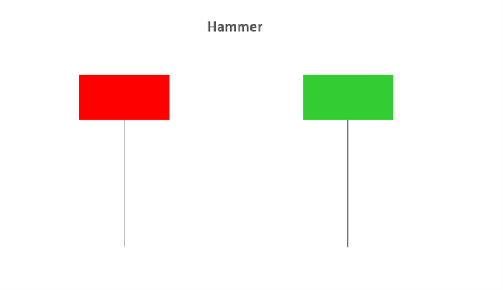
What is the project?
A candlestick is a single bar which represents the price movement of a particular asset for a specific time period.
Candlestick patterns are important tools in technical trading. Understanding them allows traders to interpret possible market trends and form decisions from those inferences. There are various types of candlestick patterns which can signal bullish or bearish movements.
The Hammer candle is viewed as a bullish reversal usually occurring at the bottom of a downward trend. This candle formation includes a small body whereby the open, high and close are roughly the same. There is a long lower wick beneath the body which should be more than twice the length of the candle body. The body may be bullish or bearish, however bullish is considered more favorable.

Slide 4
The project
The project is a GUI based desktop application, which uses Python for data aggregation, cleaning & analysis, of all the 50 stocks in the NIFTY 50 index.
Then, it uses a library called Eel, to pass these values to JavaScript, which is responsible for displaying the data to the user.
The user then gets a list of stocks which have recently formed the Hammer or inverted hammer candlestick formation, which he/she can research about further.

Slide 5
The tools
Python: The language that we are using for creating the backend of the service, for data analysis.
NSEpy: NSEpy is a library to extract historical and real-time data from NSE’s website.
Pandas: Python library for data cleansing & analysis.
Eel: Python library which acts as an interface between Python & JavaScript, used for passing values between them and creating GUI based apps
JavaScript: The language that we’re using to create a smooth GUI.
HTML & CSS: The languages used for creating skeleton & design of the GUI
Git: Version control system

Slide 6
The working
The working of the project is designed to be very simple.
The user simply clicks on an icon, and then a small window shows up. This window starts with an animation to get the user’s attention. Then, the user is greeted with a screen that tells the name of the project.
The user is then prompted to continue with a button.
On continuing, the user then sees the list of stocks which have seen the Hammer & inverted hammer candlestick formations.
On clicking on the name of the stock, the user is shown the chart of that particular stock

Slide 7
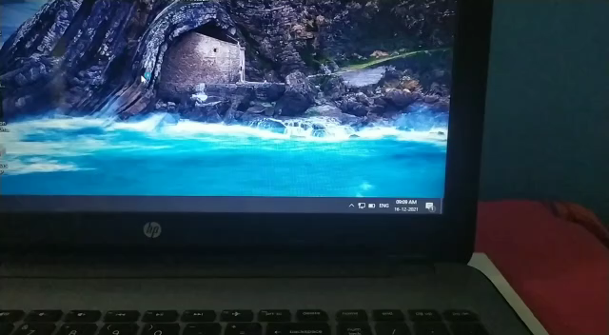
Notification system
Implemented a notification system to notify the user when new stocks have been found

Slide 8
Trend analysis
Is the stock in uptrend or downtrend?
Added simple metrics to track the health of the stock.
For eg: If the hammer of the day is Maruti Suzuki, the program says:
“MARUTI has been earning 45.49₹ per day, on average since past week. 1.47 times average earnings of this month MARUTI has been earning 30.97₹ per day, on average since past month.3.85 times average earnings of last 6 months. MARUTI has been earning 8.03₹ per day, on average since the past 6 months.”

Slide 9
UI & Design changes
The application underwent UI changes after consultation with Design students & practicing designers. A few of the changes were:
Change in the color palette of the product
Change in font family
Change in CSS3 animations

Slide 10
Thank you!

